Slide 1
KKBox‘s Churn (or lost, 流失) Prediction Challenge
106356013
游達 （Ta Yu )
Drive Github
https://drive.google.com/drive/folders/1hek8j0RuQu9v5UFfNzbTXkwXIBoRX8J4?usp=sharing
https://github.com/YuTaNCCU/1061_DS_FP_106356013_KKBoxChurnPrediction
1
Notes:
https://drive.google.com/drive/folders/1hek8j0RuQu9v5UFfNzbTXkwXIBoRX8J4?usp=sharing
https://github.com/YuTaNCCU/1061_DS_FP_106356013_KKBoxChurnPrediction

Slide 2
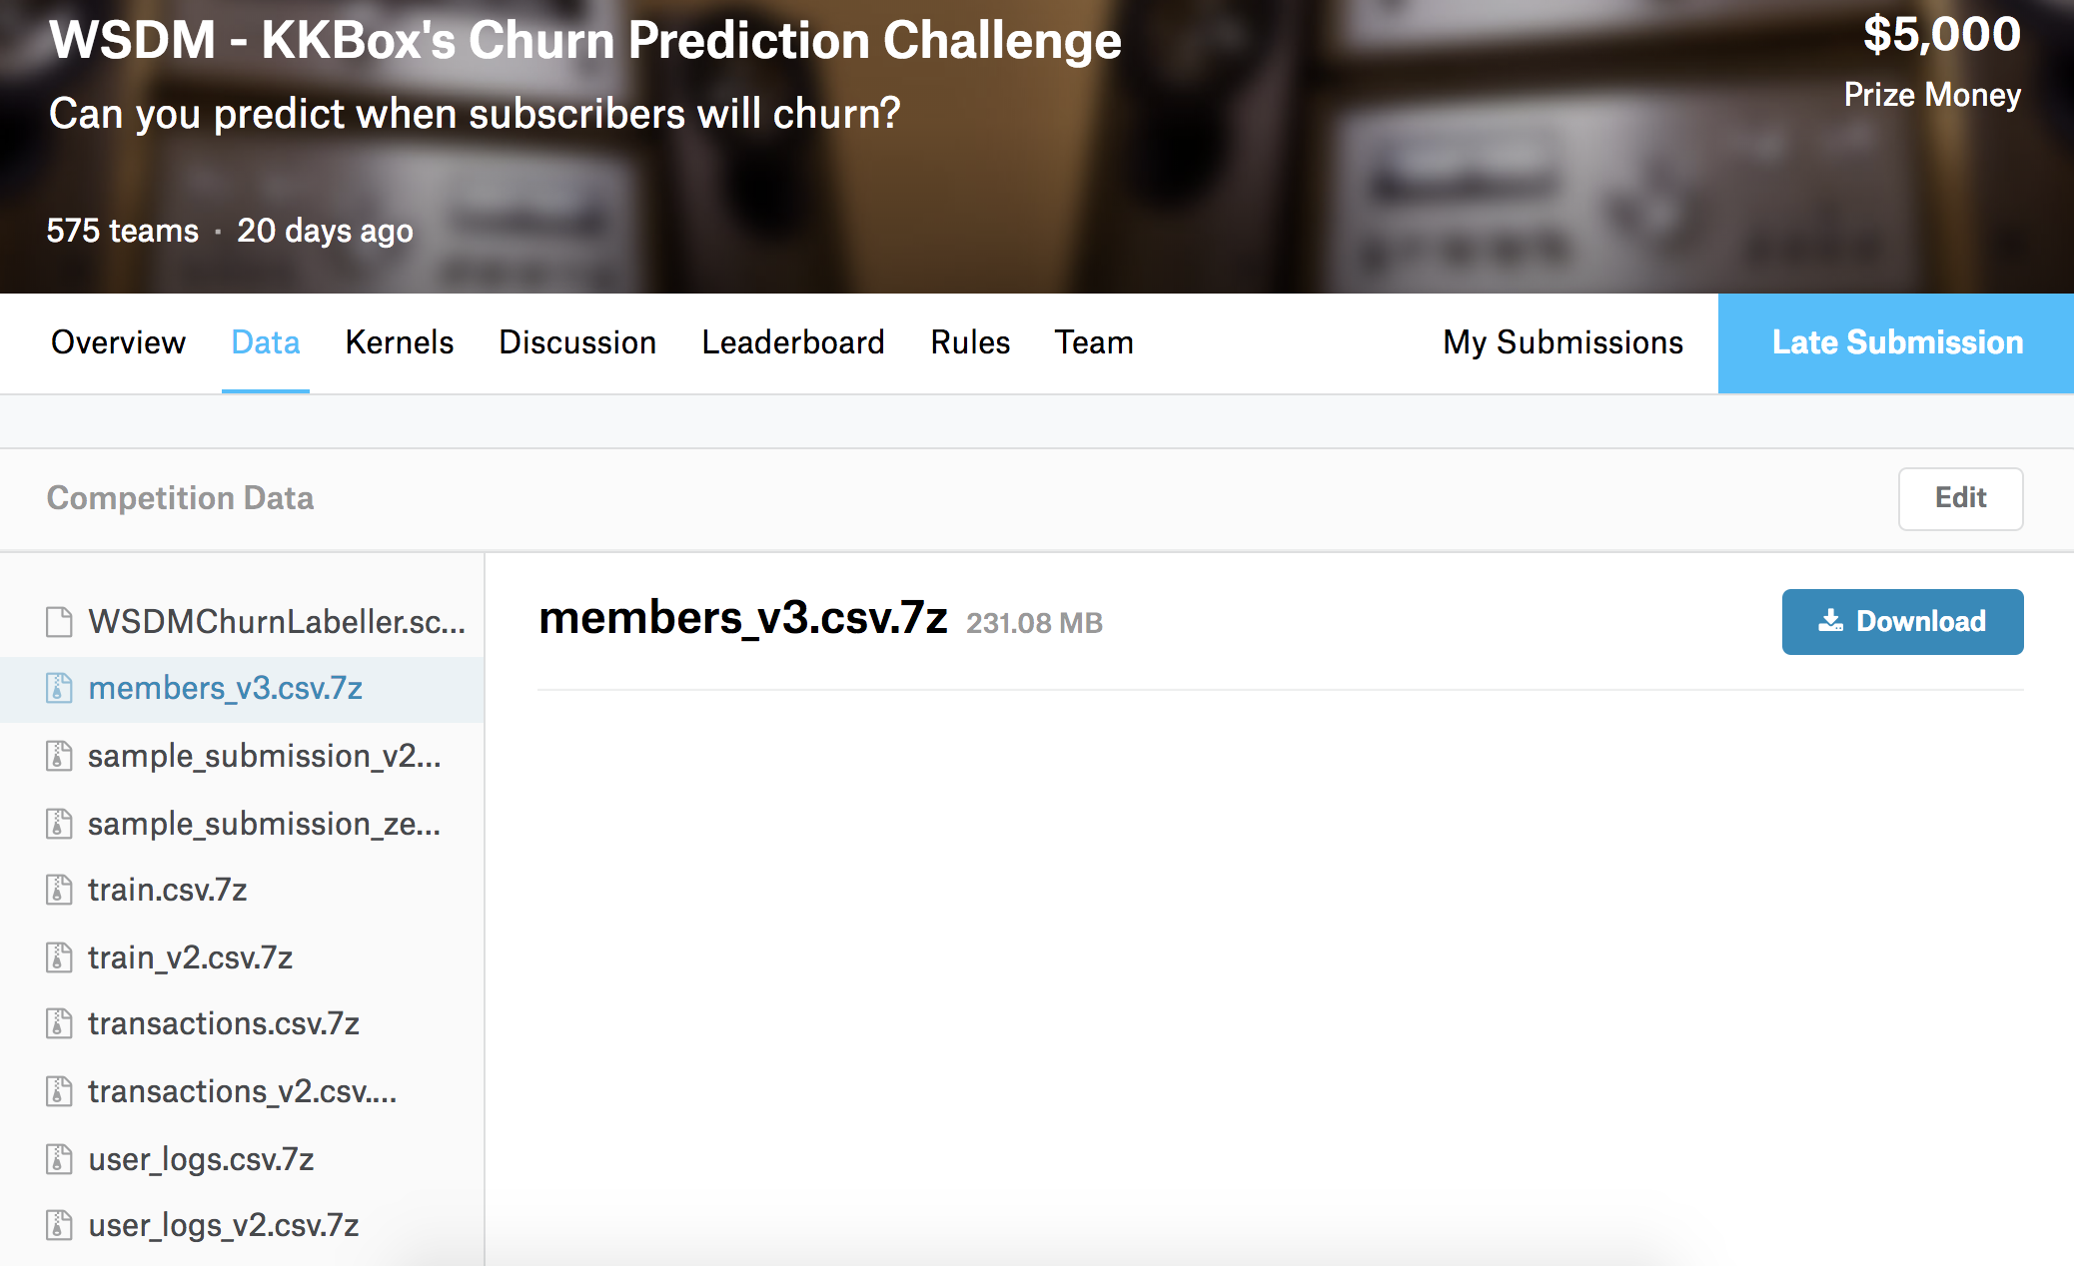
1.Input
https://www.kaggle.com/c/kkbox-churn-prediction-challenge/data
2

Slide 3
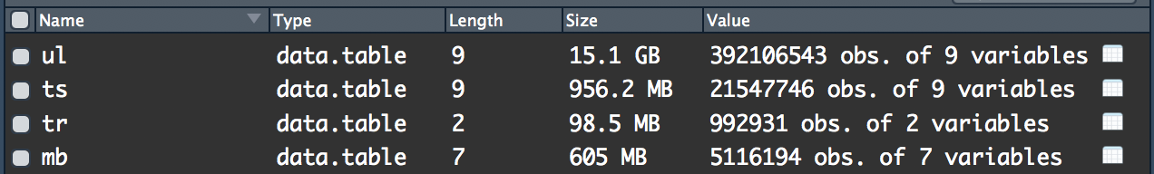
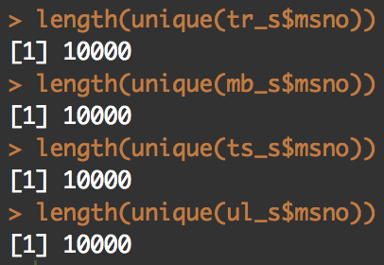
Input
4.User logs
3.Transaction
2.train
1.member
Notes:
5 million members
Randomly drew 10 thousand members for quickly computing

Slide 4
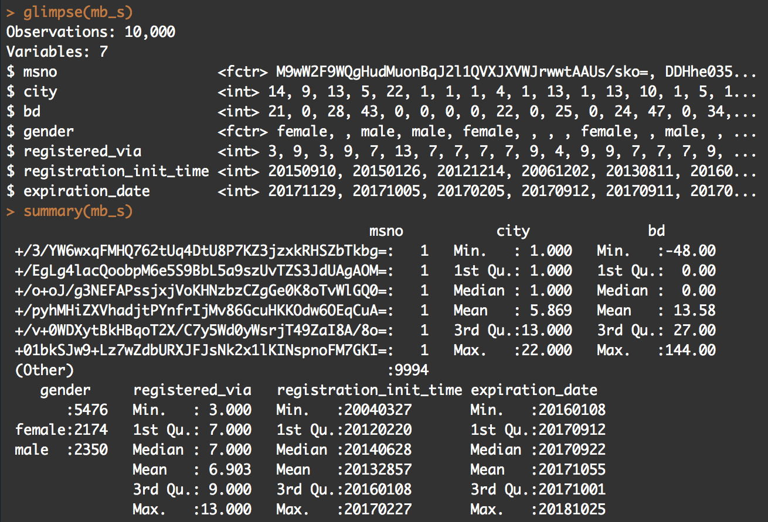
Input
4.User logs
3.Transaction
2.train
1.member
4
Notes:
Age, gender, how to register, how to pay

Slide 5
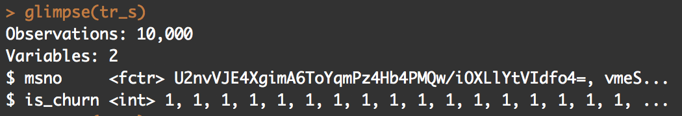
Input
4.User logs
3.Transaction
2.train
1.member
5
Notes:
One members actually churn or not after their last transaction in march 20 17

Slide 6
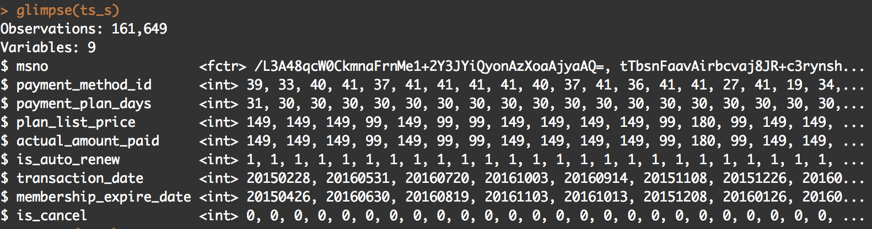
Input
4.User logs
3.Transaction
2.train
1.member
6
Notes:
How munch one members pay, when is the first payment, have the member canceled auto renew

Slide 7
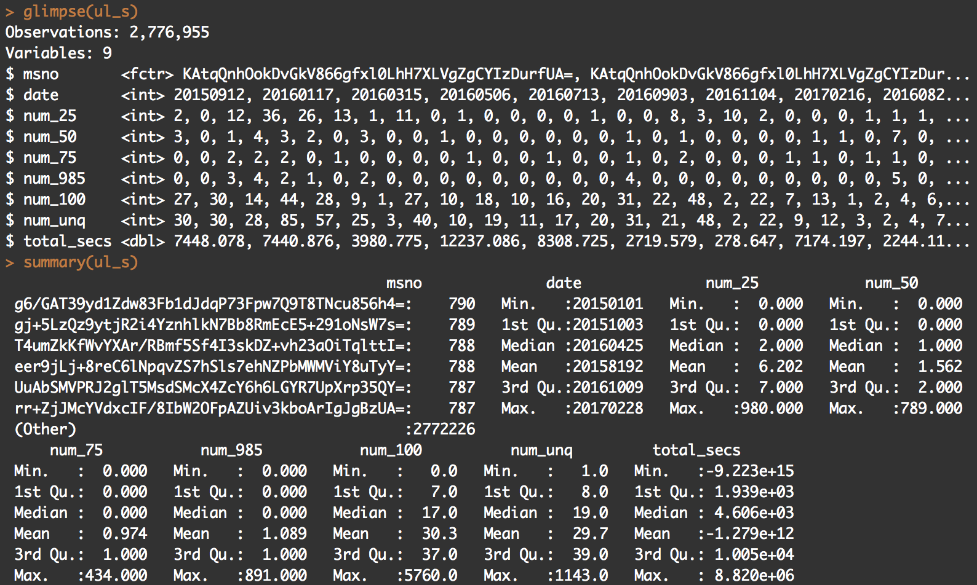
Input
4.User logs
3.Transaction
2.train
1.member
7
Notes:
Every day, total time did one member play in seconds , how many unique songs did one member play, how many songs did one member just play the 25%, 50%, 75% length of the songs...etc

Slide 8
Scale value
No, Scaling isn't required for logistic regression and random forest
The main goal of standardizing features is to help convergence of the technique used for optimization. For example, if you use Newton-Raphson to maximize the likelihood, standardizing the features makes the convergence faster.
8

Slide 9
Handle missing data
9

Slide 10
Handle missing data
10
Notes:
86 thousands 4 hundral
8.64 by 10 to the 4

Slide 11
2.method & evaluation I use
null model
logistic regression
begging logistic regression
Ramdom forests
5 fold cross valid
11

Slide 12
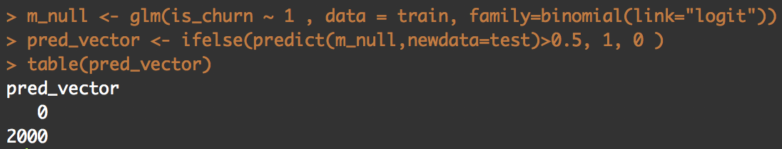
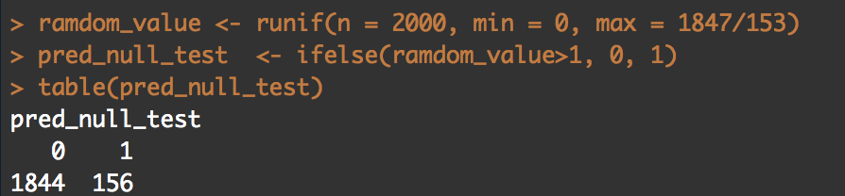
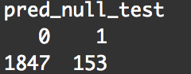
null model
12

Slide 13
method & evaluation I use
null model
logistic regression
begging logistic regression
Ramdom forests
5 fold cross valid
13

Slide 14
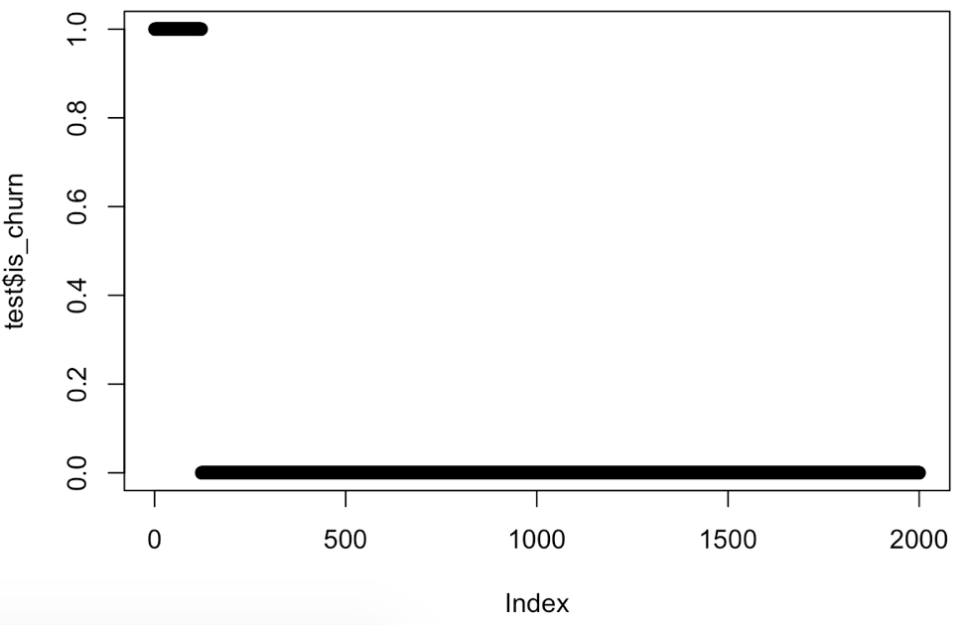
plot(test$is_churn)
14
Notes:
The first 140 obs

Slide 15
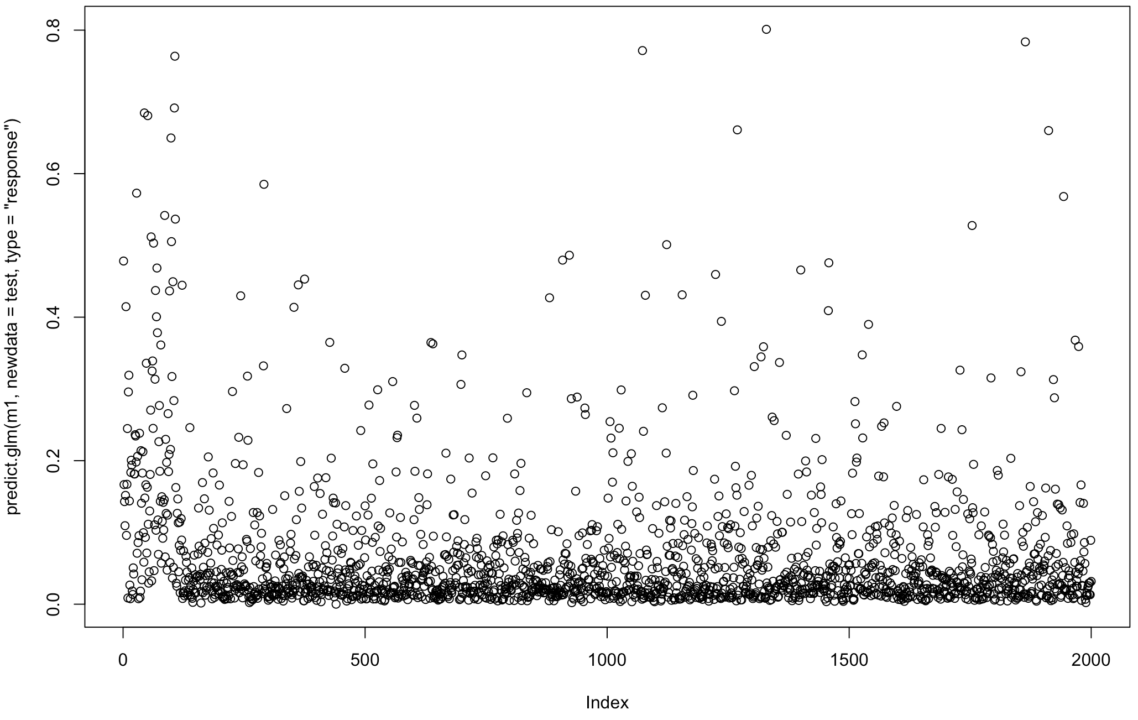
Using logistic regression
15
Notes:
Acc high
Recall low

Slide 16
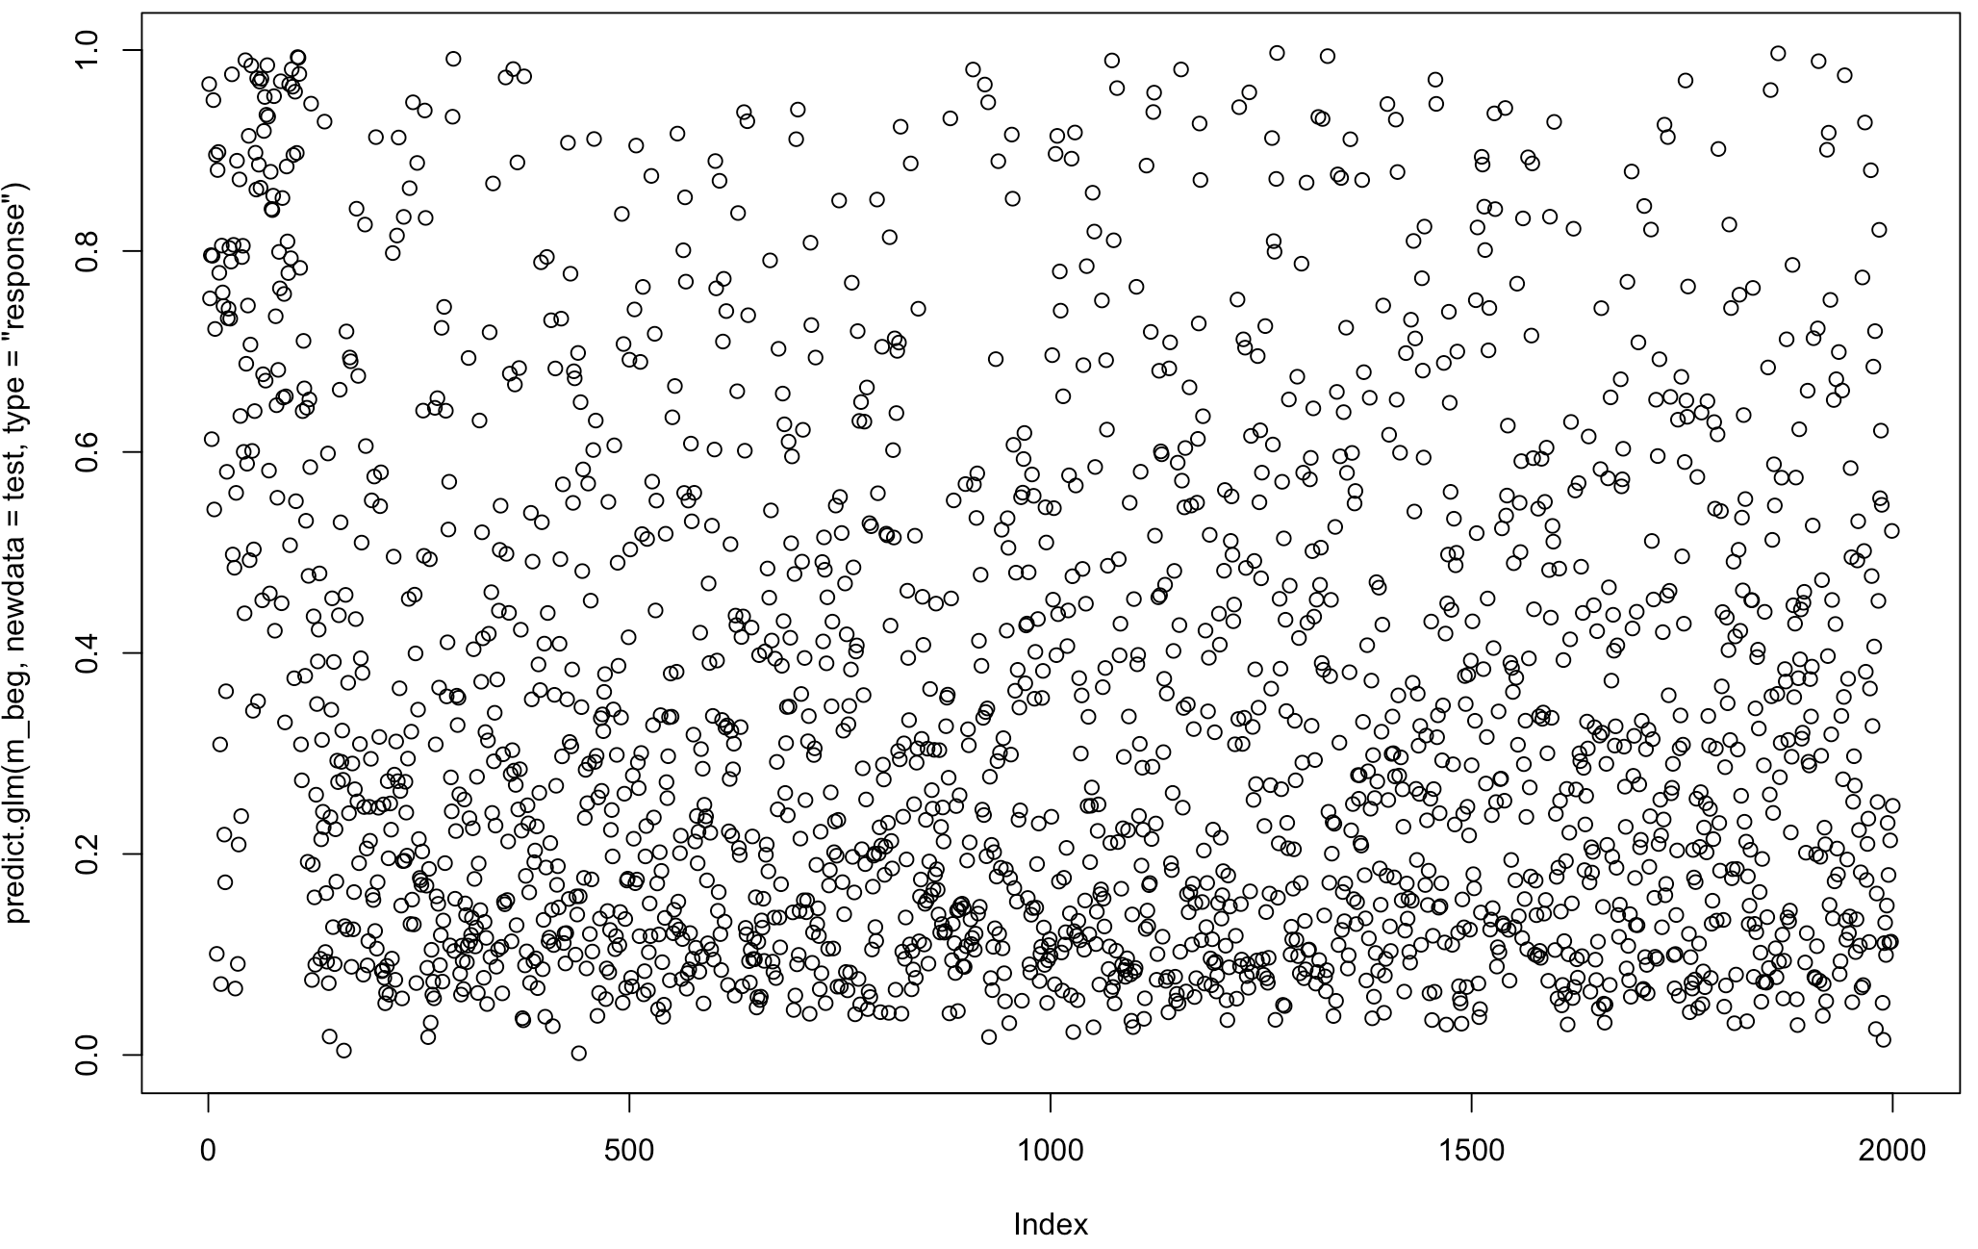
Using begging + logit for imbalanced data
16
Notes:
Recall, f1 pretty high
But low accuracy

Slide 17
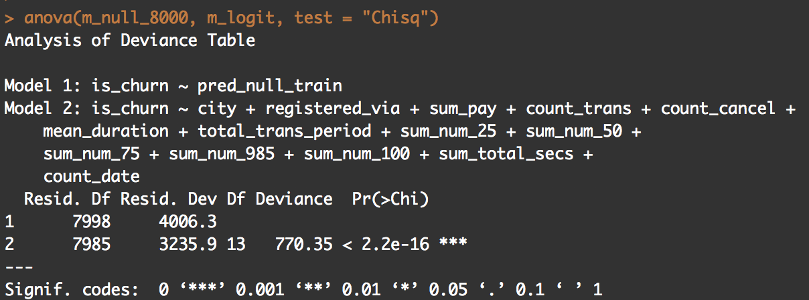
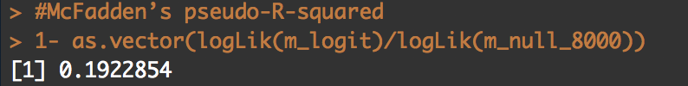
Is the improvement significant?
null model
logistic regression
begging logistic regression
Ramdom forests
p-value | pseudo-R^2
<2.2e-16 | 0.192
5 fold cross valid
17

Slide 18
3.Goal
Accuracy Paradox
there is a large class imbalance
Accuracy Paradox
Can easily predict many zero to have high accuracy
I use F1- Measure for the balance between the precision and the recall
in a problem where there is a large class imbalance, a model can predict the value of the majority class for all predictions and achieve a high classification accuracy, the problem is that this model is not useful in the problem domain
https://machinelearningmastery.com/classification-accuracy-is-not-enough-more-performance-measures-you-can-use/
18

Slide 19
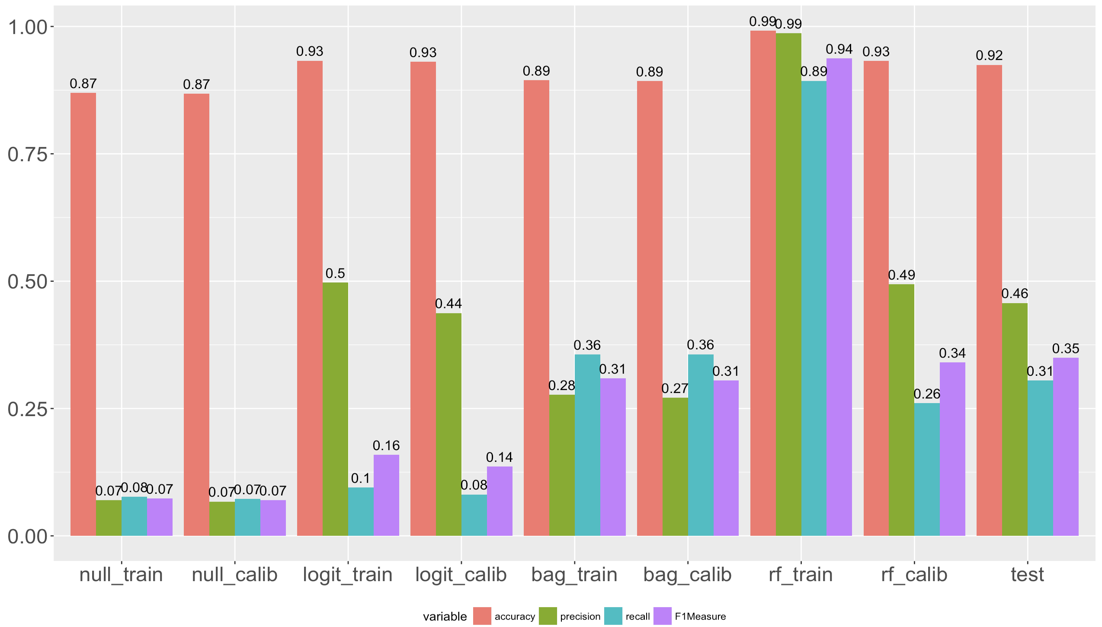


Performance
Null
Logit
Bagging Logit
Random forest
19

Slide 20
4.Github
https://github.com/YuTaNCCU/1061_DS_FP_106356013_KKBoxChurnPrediction
20

Slide 21
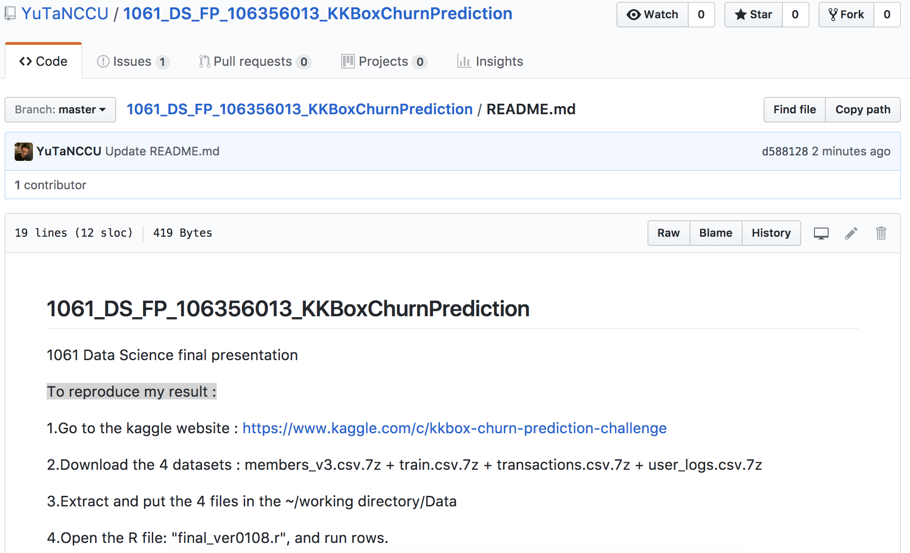
To reproduce my result :
https://github.com/YuTaNCCU/1061_DS_FP_106356013_KKBoxChurnPrediction/blob/master/README.md
21

Slide 22
What is the challenge part of your project?
Data set is too big → split data into 0.5M rows/1 csv +fread() → user ID consume much of memory → fread(…, stringsAsFactors = T)
Large class imbalance → null model +begging
22

Slide 23
KKBox‘s Churn (or lost, 流失) Prediction Challenge
106356013
游達 （Ta Yu )
Drive GitHub
https://drive.google.com/drive/folders/1hek8j0RuQu9v5UFfNzbTXkwXIBoRX8J4?usp=sharing
https://github.com/YuTaNCCU/1061_DS_FP_106356013_KKBoxChurnPrediction
23
Notes:
https://drive.google.com/drive/folders/1hek8j0RuQu9v5UFfNzbTXkwXIBoRX8J4?usp=sharing
https://github.com/YuTaNCCU/1061_DS_FP_106356013_KKBoxChurnPrediction

